Slide 1
FSM and the Kigali Amendment to the MP
Jeffrey Abraham Yamada – DECEM
March 4, 2021

Slide 2
What is the Kigali Amendment

Slide 3
In A Nutshell…
The amendment – or official change – to the Montreal Protocol. Adopted on Oct 2016, Micronesia ratified the changes in 2017
Includes HFCs – a powerful greenhouse gas – to the international list of controlled substances. It is a substance that contributes to climate change
HFC phasedown is expected to avoid up to 0.5 degree Celsius of global temperature rise by 2100, while continuing to protect the ozone layer

Slide 4
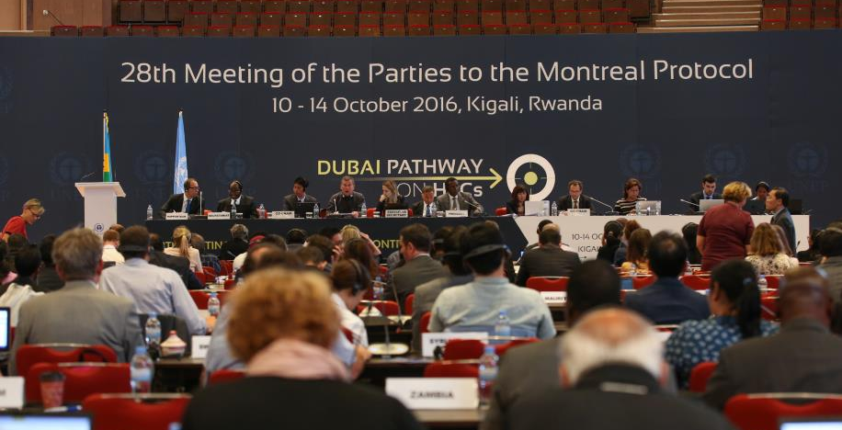

Slide 5
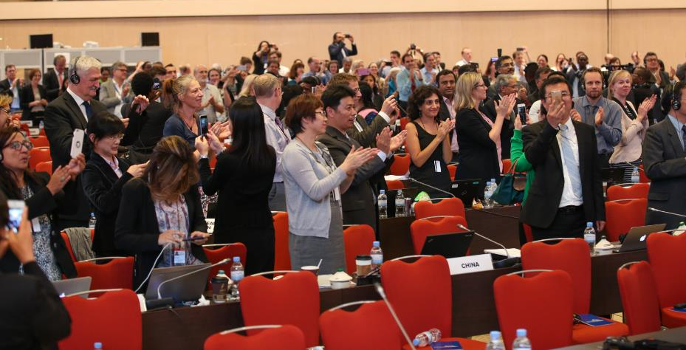

Slide 6
CFCs
01
HCFCs
02
Low GWP Alternatives (CO₂, NH₃, HC, HFO etc.)
04
HFCs
03
Amendment to the Montreal Protocol to control global consumption of HFC gases
Known to be extremely potent greenhouse gases
Substances that contribute to climate change
Ozone Depleting Substances
Non-ozone Depleting Substances
Kigali Amendment Addition
Controlled under the Montreal Protocol

Slide 7
Importance of Ozone Depleting Potential (ODP) and Global Warming Potential (GWP)
ODP = Ozone Depletion
GWP = Global Heating

Slide 8
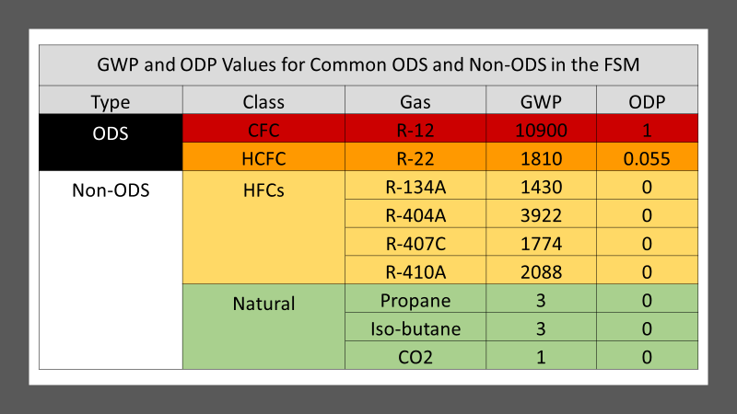

Slide 9
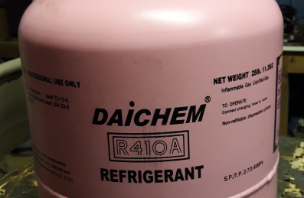
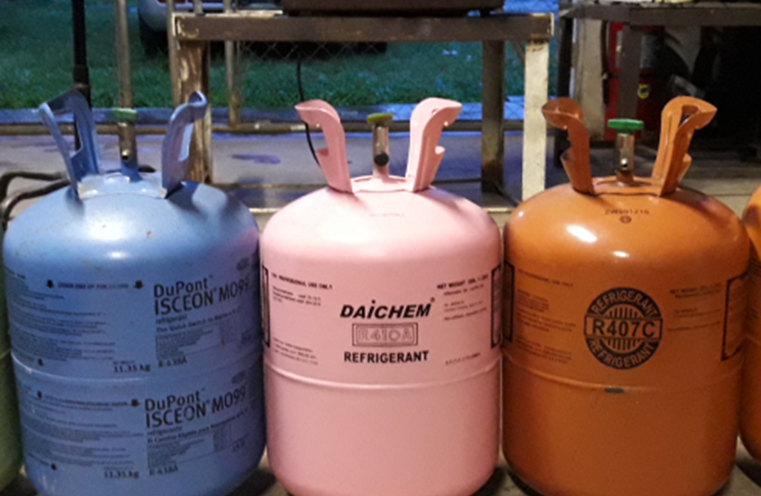
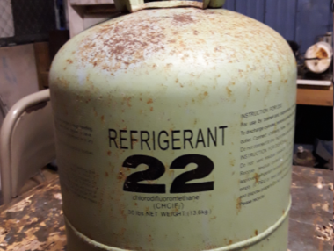
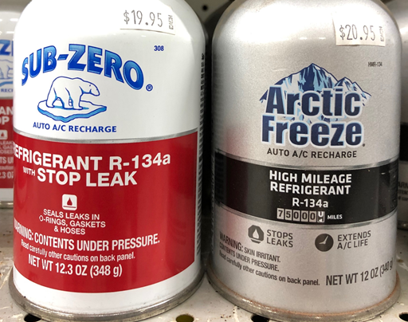
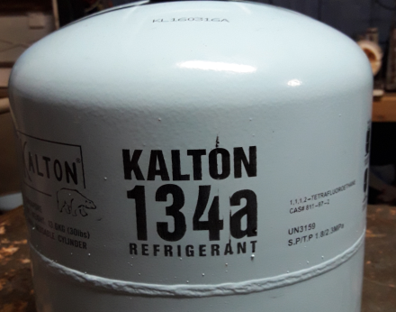

Slide 10
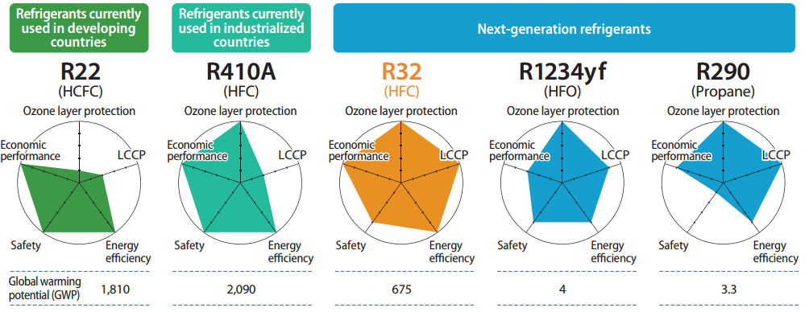
The next wave of refrigerants

Slide 11
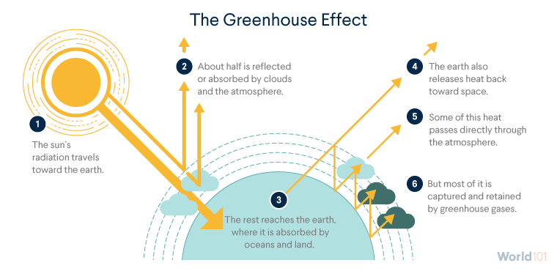
Another Threat – Climate Change

Slide 12
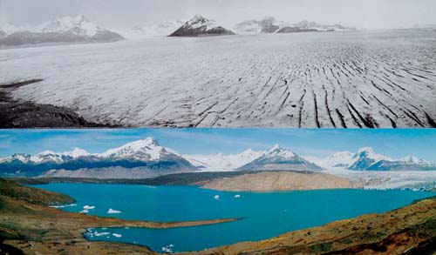
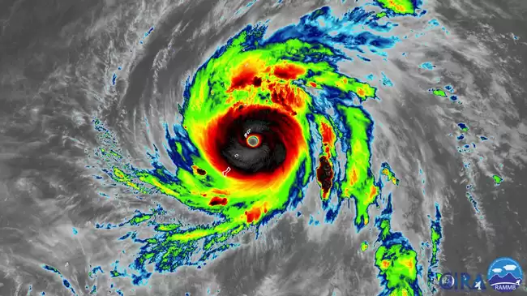
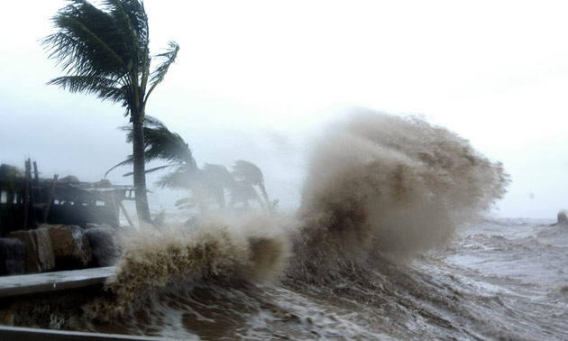
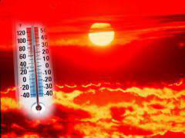
Climate change impacts

Slide 13
FSM’s Plan under the Kigali Amendment
FSM ratified the Kigali Amendment on
12 May 2017

Slide 14
Obligations under the Kigali Amendment
Licensing system (Article 4B)
Permits issued on a “ per shipment” basis for HFC single substances and blends
Data reporting
Article 7 annual HFC data for the year of entry into force must be reported in the following year ,
Baseline reporting – timing to be clarified
Phase down schedule for Annex F (HFCs)
A5 Group 1 parties to freeze consumption from 2024, ensure stakeholders are aware
Specific HS codes for HFC monitoring
Supporting the country to establish national HS codes for single substance HFC and blends--Customs
Policy and Legislation
Banning HCFC equipment or restricting imports of high GWP HFCs – when alternatives become commercially available

Slide 15
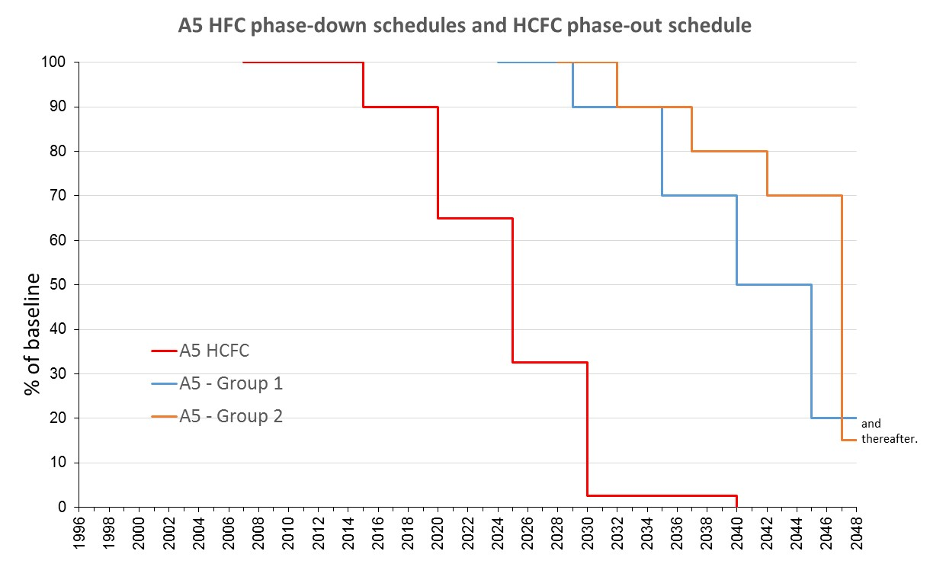
FSM = Group 1

Slide 16
What is the Phase-down Schedule?
 | Article 5 Parties: Group 1
Baseline Years | 2020, 2021 & 2022
Baseline Calculation | Average production/consumption of HFCs in 2020, 2021, and 2022 plus 65% of HCFC baseline production/consumption
Reduction steps Freeze | 2024
Step 1 | 2029 | 10%
Step 2 | 2035 | 30%
Step 3 | 2040 | 50%
Step 4 | 2045 | 80%

Slide 17
Next Steps for FSM
Country Assessments
& Stakeholders Workshop
Article 4B Licensing & Reporting
Establish an HFC licensing and quota for trade control as well as data monitoring and reporting system
Explore the possibility and if so, develop an electronic licensing system
Sensitize the stakeholder on the Kigali Amendment
Conduct assessment and develop country assessment report
C
A
C
C
Training workshop to strengthen capacity of the local stakeholders to follow the best practices for installation & servicing
Apprehend knowledge and understanding of the general public and implementing partners
Capacity Building
for safe use of ODS alternatives
Sensitizing and building capacity of servicing sector on development of holistic approach and strategy to address the challenge for adoption of lower GWP alternatives (including fisheries and marine sector, if applicable).
Communication & Public Awareness

Slide 18
Thank You!
Any Additional Questions?

Slide 19
Time for a quick video to summarize all the Montreal Protocol and the Kigali Amendment

